Slide 1

Comparing Genomic Expression Between Adults and Children Infected with Covid-19
Hudhayfah Ilyas
Ammar Syed
Group 8
11/30/2021

Slide 2
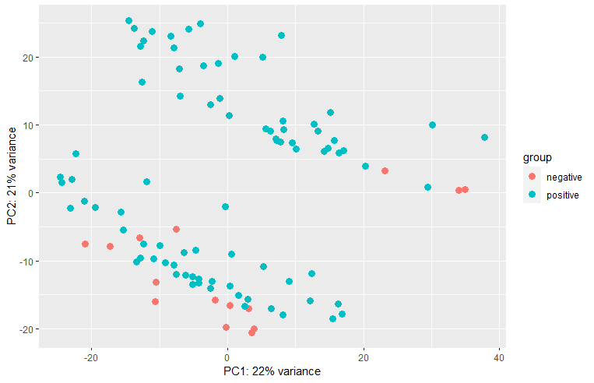
Introduction
The data we used was an RNA high throughput sequencing dataset that had the gene signatures of Covid-19 throughout the duration of the disease in two different age groups, children and adults.
The approach we took to get our answer was to first explore the data and then perform predictive modeling on it.
When exploring the data, we created a density plot of the gene expressions, a PCA plot to look at groups and trends, a volcano plot to look at fold changes, and a heatmap.
We then performed predictive modeling such as clustering and Chi square test of independence.
PCA Plot

Slide 3
Hypothesis
How does gene expression differ between adults and children infected with Covid-19?
The gene expression would differ significantly between adults infected with Covid-19 compared to children infected with Covid-19.
The motivation behind this hypothesis is that it is often said that children have much milder symptoms of Covid-19 compared to adults.
We seek to find any significant expression differences between infected adults and infected children.

Slide 4
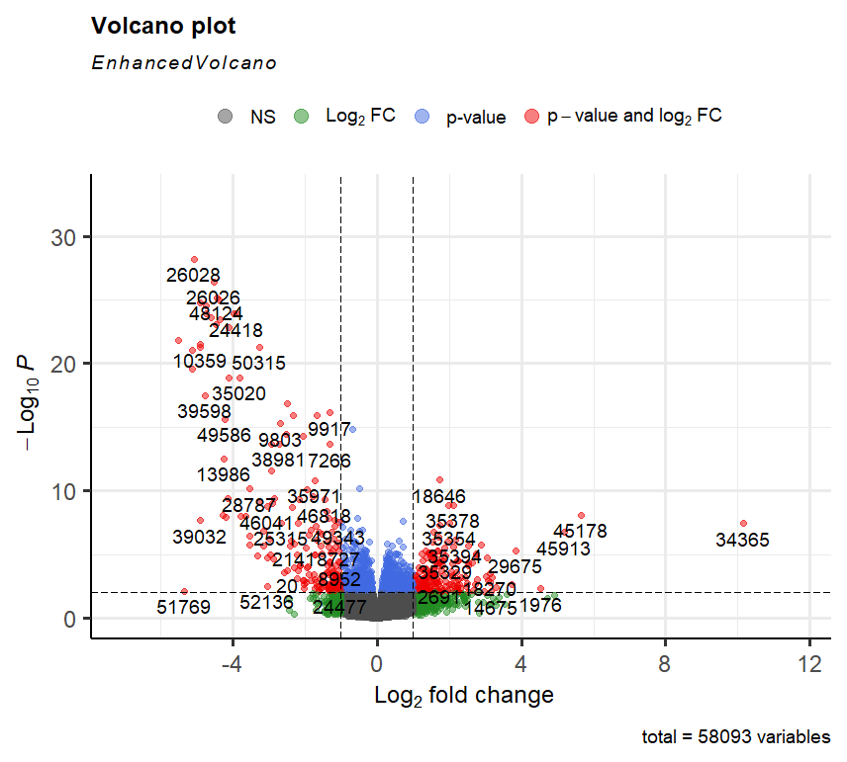
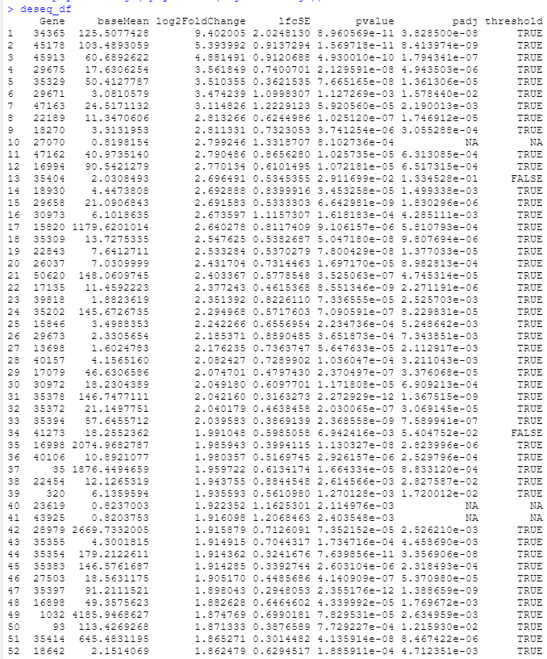
Differential Expression and Enrichment Analysis
The differential expression analysis identifies the genes with significantly varying expression

Slide 5
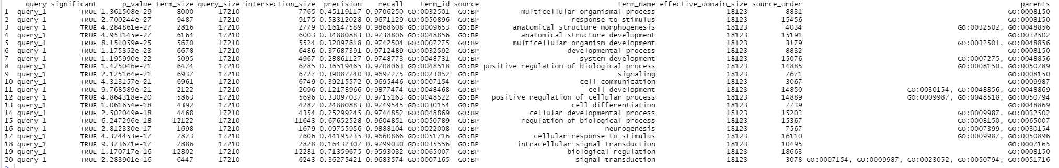
Differential Expression and Enrichment Analysis
The enrichment analysis used was gene ontology using gprofiler2
The differential and enrichment analysis provides useful information about significant gene expression, however it does not directly answer our hypothesis in finding significant differences between gene expression.

Slide 6
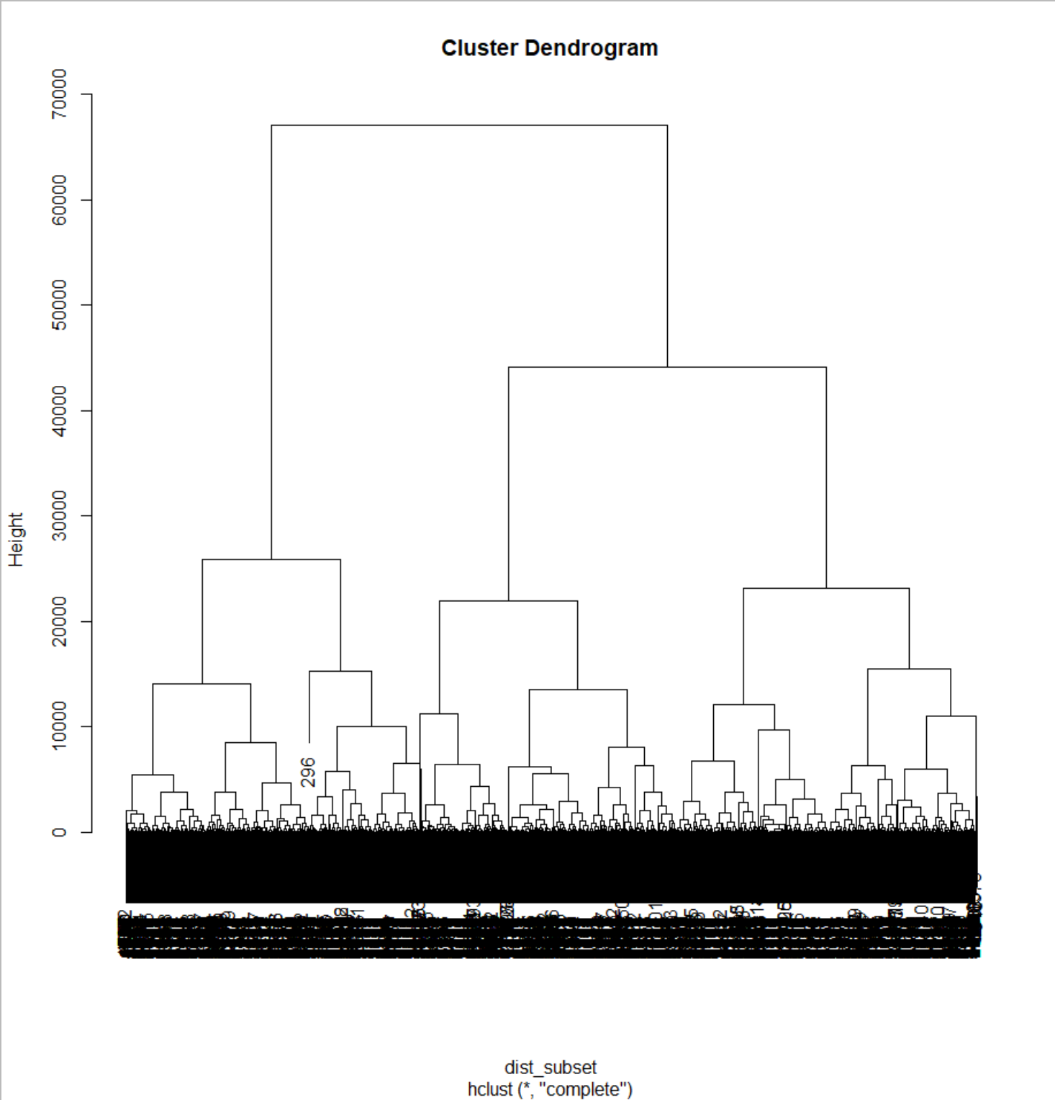
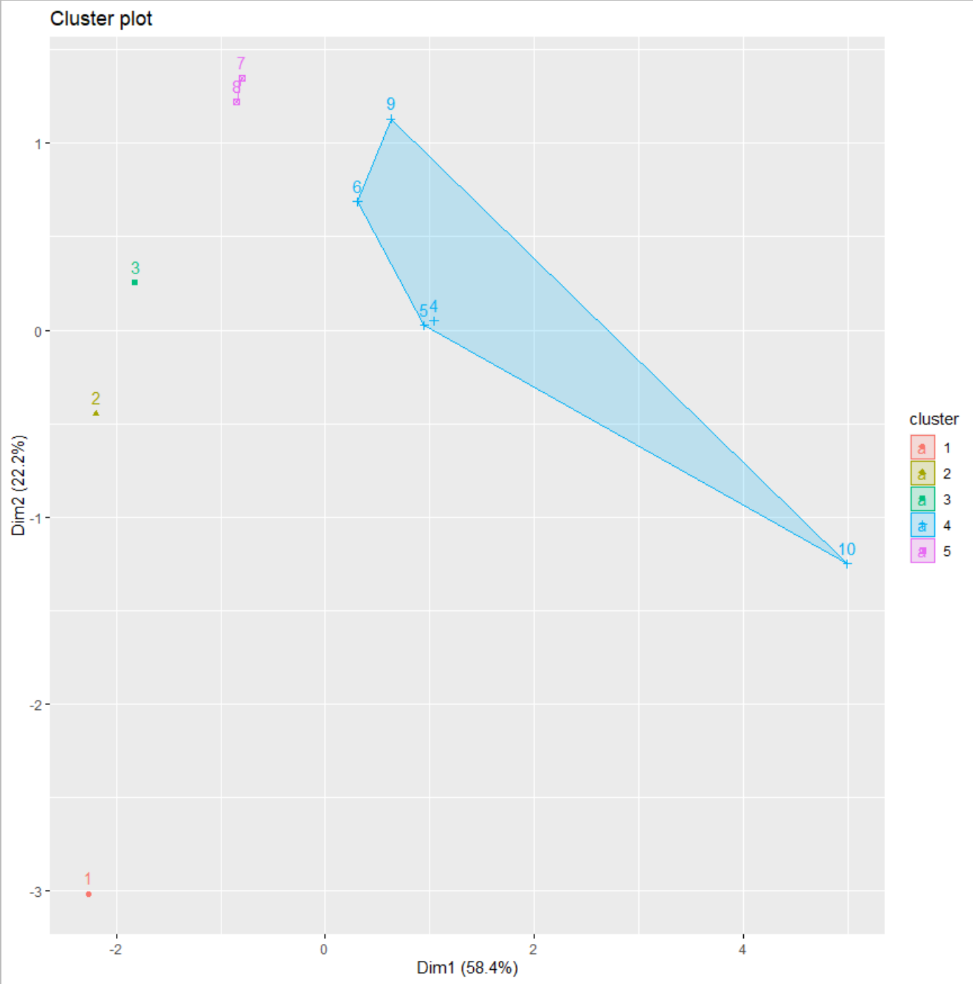
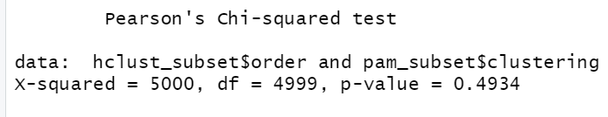
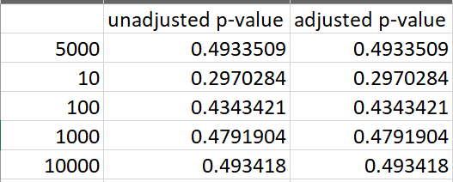
Clustering & Enrichment Analysis
Hierarchical Clustering
PAM Clustering
Chi square test of independence
Our findings from clustering provided insight
however we were unable to prove our
hypothesis.

Slide 7
Conclusions & Future Work
Our findings showed that there was no significant difference in the way that the gene signatures were being expressed between children and adults infected with Covid-19
We hypothesized that the gene signatures would be expressed differently between adults and children infected with Covid-19.
In assignment 2, we identified the most significant genes and noticed that the data was separated into two groups in our PCA plot.
In assignment 3, we performed clustering as well as a chi squared test and our results showed that we did not have significant evidence to say that the gene signatures expressed between children and adults infected with Covid-19 were different.
Throughout this project, the team learned how to preprocess data, apply expression analysis techniques like generating a PCA plot and expression matrix and enrichment/differential analysis, perform unsupervised and statistical analysis such as PAM clustering, Hierarchical clustering, and the Chi squared tests, and create heatmaps and plots that helped us identify trends in our data.
We would improve our analysis by applying different techniques when finding significant genes and expand our use of clustering to find significant results.
A question we now have is how does gene expression differ between adults and children who have been given the Covid-19 mRNA vaccine?

